Slide 1


Securely connect to SharePoint online from Azure Function by Joel Rodrigues
collabdays | lisbon
November 13th, 2021

Slide 2







Our Sponsors
GOLD
COMMUNITY

Slide 3


Joel Rodrigues
SharePoint Developer at Storm Technology Ltd
Microsoft MVP - Office Development
Microsoft 365 Patterns and Practices (PnP) team member
PnP Controls maintainer
10+ years developing SharePoint solutions
@JoelFMRodrigues
https://www.m365-dev.com
LET ME INTRODUCE MYSELF…

Slide 4
Typical scenario to consider
Azure Function to connect to SharePoint using app-only permissions
Trigger Function via HTTP request
From Logic Apps or PowerAutomate
From the browser as an end-user via SPFx
From .NET (MSAL)
From other Function

Slide 5

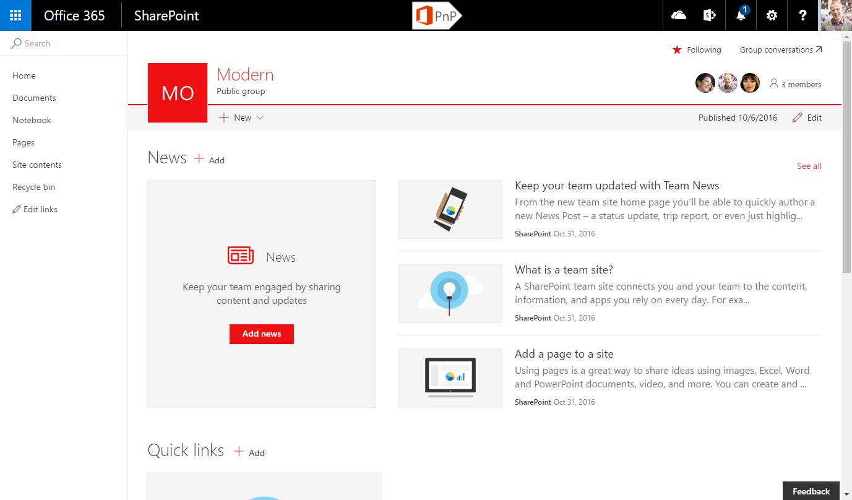

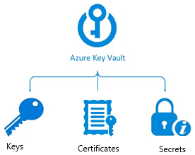
Connect to SharePoint using Azure AD app and certificate
Function execution started
Function code requests app Id and Certificate from Function app settings. Function uses Key Vault references to request the values using managed identity
Key Vault ensures Function has access permissions to execute the request and returns values
Function uses App Id and Certificate to connect to SharePoint
Azure Function
1
4
2
3
Connect-PnPOnline -Url $SiteUrl -ClientId $AuthId
-Tenant "$SPOTenant.onmicrosoft.com"
-CertificateBase64Encoded $Certificate

Slide 6
Function Code
$siteUrl = "https://contoso.sharepoint.com/sites/demosite"
$AuthId = $env:AuthId
$SPOTenant = “contoso.onmicrosoft.com"
$Certificate = $env:Certificate
Connect-PnPOnline -Url $SiteUrl -ClientId $AuthId -Tenant $SPOTenant -CertificateBase64Encoded $Certificate
Write-Information "Connected to site"
Get-PnPList
Write-Information "Done!"

Slide 7
When you create a new Function…
What security is already in place?
How is access controlled?
Who can access the Function?

Slide 8
By default, everyone… so we need to secure it

Slide 9
Connect to Function from SPFx
const options: IHttpClientOptions = {
headers: {
"Content-Type": "application/json;odata=verbose",
Accept: "application/json;odata=verbose",
},
body: JSON.stringify({
APIData: data
})
};
const client: AadHttpClient = await this.wpContext.aadHttpClientFactory.getClient(apiUrl);
const response: HttpClientResponse = await client.post(apiUrl, AadHttpClient.configurations.v1, options);
const result: any[] = await response.json();

Slide 10
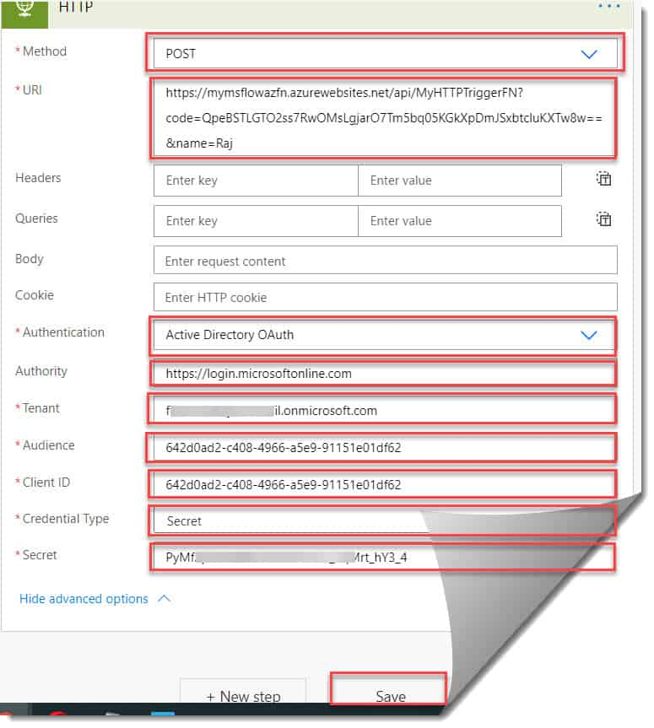
Connect from Logic App or PowerAutomate

Slide 11
Demo
Azure AD application
API permissions
Certificate
Key Vault
Secrets
Certificates
Access Policies
Azure Function
Managed Identity
App settings
Authentication

Slide 12
Recommendation Using a Function template solution to:
Automate the entire setup process
Functions always fully configured from the start
Ready to use
Time saving
Less mistakes

Slide 13
Resources
Granting access via Azure AD App-Only | Microsoft Docs
Calling An Azure Function From Power Automate (MS Flow) - Azure Lessons
Learn about MSAL - Microsoft identity platform | Microsoft Docs
AzureAD/MSAL.PS (github.com)
Calling Azure Function from PowerShell - Simon Wahlin
Connect to API secured with Azure Active Directory (Azure AD) | Microsoft Docs
Use Key Vault references - Azure App Service | Microsoft Docs

Slide 14
Our Sponsors
GOLD
COMMUNITY

Slide 15


